Slide 1
Synergy: Looking Beyond GPUs for DNN Scheduling on Multi-Tenant Clusters
Jayashree Mohan, Amar Phanishayee, and Janardhan Kulkarni, MS Research; Vijay Chidambaram, The University of Texas and VMware Research
USENIX OSDI‘22
슬라이드 노트에 각 장별 설명이 나와있습니다!
Presented by Yejin Han
yj0225@dankook.ac.kr

Slide 2


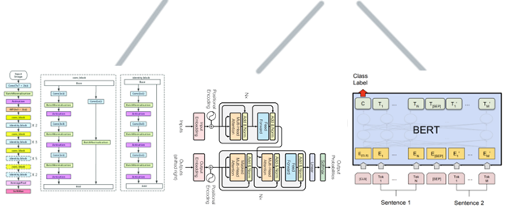
Introduction
DNN training on multi-tenant clusters
Co-locating training workloads in a shared, multi-tenant cluster is a common setup
Scheduler
V100 GPU
…
image
NLP
…
Notes:
Training a DNN model is a resource-intensive and long-running task. Many users, today, train their DNN models, using a shared clusters
So collocating training workloads in a multi-tenant cluster is a very common setup.
And these jobs of course are scheduled using a cluster scheduler.

Slide 3
Introduction
DNN training on multi-tenant clusters
Co-locating training workloads in a shared, multi-tenant cluster is a common setup
Scheduler
V100 GPU
Optimus, EuroSys’18 Gandiva, OSDI’18
Tiresias, NSDI’19
Allox, EuroSys’20
Gavel, OSDI’20
…
…
image
NLP
…
Existing DNN cluster schedulers allocate resources GPU-proportional
Notes:
There are many prior works on DNN-specific schedulers like Optimus, Gandiva, gavel, etc.
And all of them allocate resources using a GPU-proportional allocation.

Slide 4
What is GPU-proportional allocation?
User requests a fixed number of GPUs for their DNN job
Other resources are allocated proportional to the number of GPUs
GPU
1
GPU
2
GPU
3
GPU
4
Job requests
200GB DRAM
1 GPU
16 CPUs
Notes:
It means that DNN schedulers consider GPU as a dominant resource and allocate other resources like CPU and memory to the same portion of that. Let’s say there is a server with 4 GPUs and 200GB memory and 16 cpus. If a user requests 1 GPU, which is 25% of the GPU capacity, then (다음 슬라이드)

Slide 5
What is GPU-proportional allocation?
User requests a fixed number of GPUs for their DNN job
Other resources are allocated proportional to the number of GPUs
GPU
1
GPU
2
GPU
3
GPU
4
GPU
1
GPU
2
GPU
3
GPU
4
Job requests
200GB DRAM
50GB
150GB
1 GPU
16 CPUs
4 CPUs
8 CPUs
Notes:
50GB memory and 4 CPU are allocated to the job, which is the same portion of that.

Slide 6
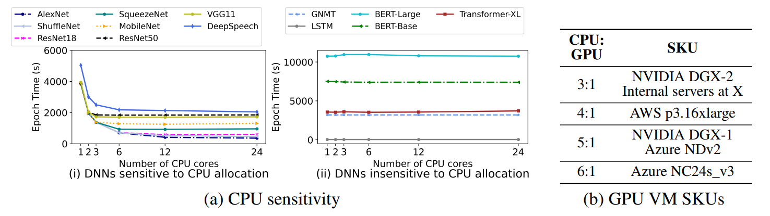
Motivation: Resource-sensitivity
DNNs exhibit varied sensitivity to the amount of CPU and DRAM
We need to consider resource sensitivity of DNN training jobs
Notes:
But, this paper find that there is a different resource sensitivity during training,
so instead of just using GPU-proportional allocation like existing schedulers, we need to consider their own resource requirement
so that improve overall cluster utilization.
So let’s look at CPU sensitivity for various DNNs uh…
graphing the number of CPU cores on the x-axis. From 1 to 24 cores. And on the y-axis per epoch time in terms of second.
And this was trained on a single GPU.
So as we can see on the left side // most image and speech models are sensitive to CPU allocations.
Because they perform kinda heavy pre-processing like image clipping, flipping.. Some kind of things that cpu handles. So increasing the CPU to GPU ratio will reduce epoch time. But on the right side, the models are insensitive to the number of CPU cores that are allocated to them, it’s because they don’t perform data augmentation in every epoch like image models.
So this is cpu sensitivity.
And in the memory side, they didn’t show the graph but, in the paper, they said that image models is also memory sensitive not like language model like GNMT.

Slide 7
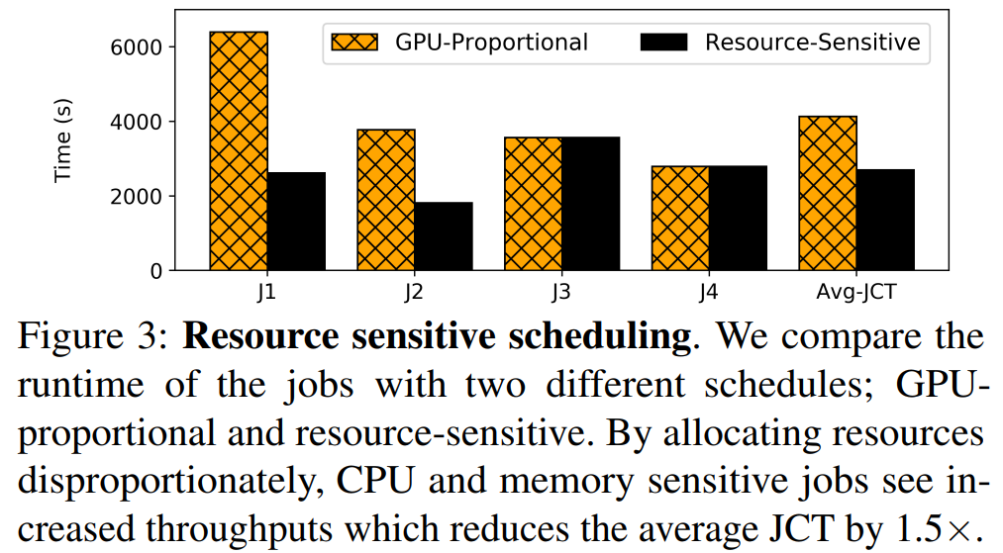
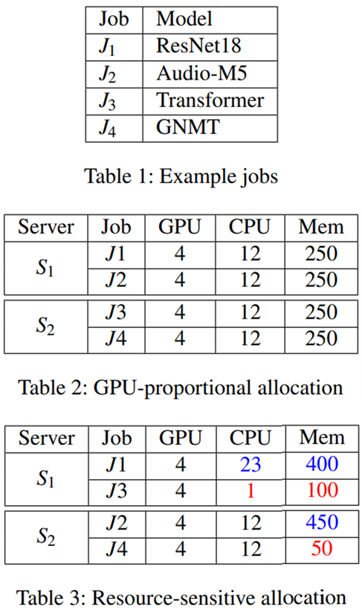
Motivation: Resource-sensitivity
Co-locate a CPU/memory sensitive job with an insensitive one
X1.5
Notes:
So we can think of like this. If we co-locate a CPU/memory sensitive job with an insensitive one in a same server then it can improve the overall cluster throughput by utilizing the resources, compared to GPU-proportional allocation.
And we can tell, this, from Figure 3. j1 and j2 is resource-sensitive job and j3 4 is resource insensitive. There are 4 jobs in the scheduling queue and each of them requests 4 GPU. And compared to the GPU proportional, in the resource-sensitive, the average Job completion time drops by 1.5 times.
So again, if we allocate CPU and memory in a resource sensitive way, it makes higher resource utilization and better performance.

Slide 8
What are the challenges?
What is the ideal resource requirement for each job?
How can this be determined with low overhead?
How should we pack these jobs onto servers efficiently?
Notes:
Then what are the challenges in a resource-sensitive scheduler?
First, What is the ideal resource requirement for each job and second there should be of course low overhead to find this.
Thrid, how should we pack these jobs onto servers efficiently?
These are questions that we’re curious about. And Synergy will address these.

Slide 9
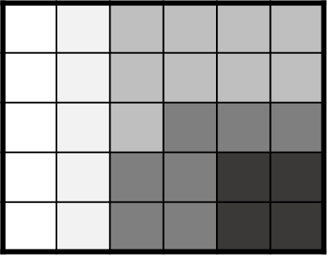
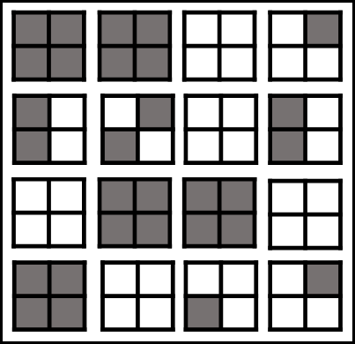
Synergy
* FIFO: First In First Out
* SRTF: Shortest Remaining Time First
* LAS: Least Attained Service
Synergy is a round-based scheduler that arbitrates GPU, CPU, and memory
It identifies the job’s best-case CPU/memory requirements
It packs DNN jobs to the available servers
Near-optimal
heuristic algorithm
Placement Policy
optimistic
profiling
round i
FIFO, SRTF, LAS, etc
1
2
3
Profiler
1
2
3
Scheduling Policy
Incoming queue
scheduling queue
Cluster
…
Notes:
Synergy is a round based scheduler that arbitrates GPU, CPU and memory and it covers a wide range of scheduling policies like FIFO, SRTF, LAS, etc.
And this is a overall process of Synergy.
First, from the incoming job queue, Synergy profiles and identifies each job’s best case cpu and memory requirements using optimistic profiling. And after that the job goes to the scheduling queue.
And depending on the scheduling policy, Synergy selects a job according to the priority. This scheduling happens in rounds of fixed time duration like 5 minutes. And using placement policy, the jobs are packed onto the cluster. And at the end of that round, the runnable jobs are updated using the scheduling policy, and their placement decisions are recomputed.
So the main 2 parts are profiling and placement.

Slide 10
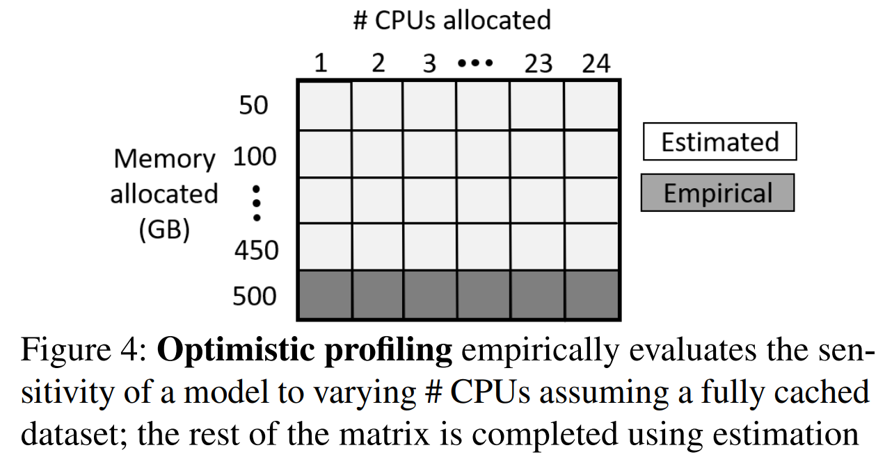
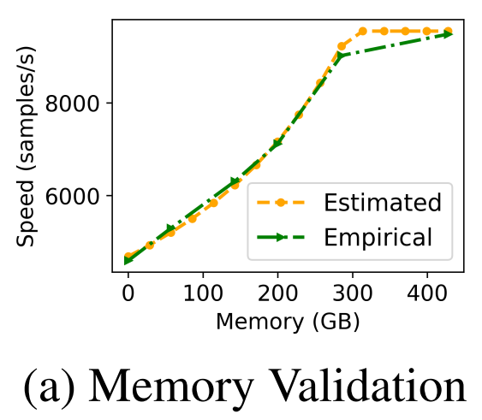
Optimistic Profiling
Resource-sensitivity matrix for combinations of CPU and memory
Predictable job performance to memory allocation
Using DNN-aware caching MinIO (VLDB’21)
*8-GPU ResNet18 job
Full memory allocation
Notes:
First, optimistic profiling.
DNN training job is profiled for its resource sensitivity when the job arrives. Each incoming job is profiled by changing the CPU and memory allocated to the job. And resource-sensitivity matrix for this/// is then made.
But naively profiling all combinations can be very expensive. And like I said, there must be low overhead for making this.
The way that Synergy address this is using predictability of job performance to memory allocation under MinI/O which is DNN-aware cache.
Well this MinI/O is also from the same author of this paper. To explain briefly, MinI/O provides memory isolation across jobs sharing the machine, so it is possible to predict cache performance predictable and it reduces synergy’s profiling cost.
Therefore, we only need to empirically profile the job for changing Cpu values at full memory allocation. And all the other entries can be estimated. In Figure 5, we can see that this optimistic profiling. And the estimations are very similar to the empirical results. So we don’t have to actually run the model for all of that combinations.

Slide 11
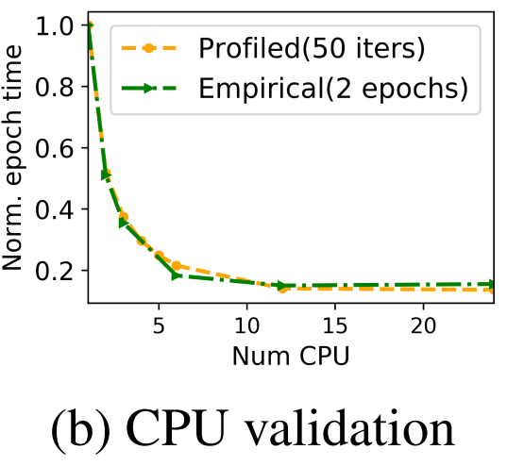
Optimistic Profiling
Pick the minimum value of (CPU + memory) that saturates max throughput
*1-GPU ResNet18 job
# CPUs allocated
1 2 3 6 12 24
Higher train time
Memory
allocated
(as % of
dataset
cached)
25%
35%
50%
75%
100%
Lower train time
Notes:
And Synergy identifies the best-case values using this profiled resource sensitivity matrix. It picks the minimum value of CPU and memory that saturates the job throughput.
And figure 5 is about CPU validation for this profiling. Whether we profile the epoch time per 50 iterations or per 2 epochs, these are very close, and more than that, in the empirical way, it just takes under 8 minutes. So from this, it can also make lower overhead.

Slide 12
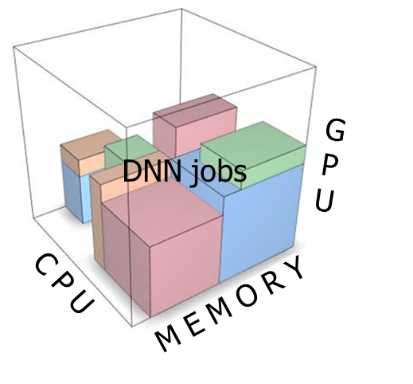
Job placement
What is the best placement for a set of jobs in the given round?
Multi-dimensional bin packing problem
Placement Policy
Cluster
1
2
3
Scheduling Policy
3
Notes:
And next, we’re gonna talk about the job placement on to the server. Now we know the best-case resource requirement from the previous profiling.
But how we can place a set of jobs in the given round? It is like a multi-dimensional bin packing problem. And we’re gonna talk about this.

Slide 13
Synergy-TUNE scheduling
Identifies runnable jobs for the current round from the scheduling queue
1
2
3
priority queue
(runnable jobs)
Notes:
For the job placement on to the cluter, Synergy introduces a new heuristic tuning mechanism, called synergy-tune.
And for the job fairness in terms of throughput, we need to ensure that no job runs at a throughput lower than that of a GPU-proportional share.
Let’s say that we use SRTF scheduling policy. There are a set of jobs waiting in the queue to be scheduled.

Slide 14
Synergy-TUNE scheduling
The next job to be scheduled with the priority is picked from the queue
CPU = 12
Mem = 250GB
GPU = 2
1
2
3
priority queue
(runnable jobs)
Notes:
And then the next job to be scheduled with the shortest remaining time is chosen from the queue.
And all the jobs are having a resource demand profile which indicates its best case CPU and memory requirements as predicted by the optimistic profiling technique.

Slide 15
Synergy-TUNE scheduling
Synergy checks if the jobs demand can be fitted in the cluster
CPU = 12
Mem = 250GB
GPU = 2
1
Fits in
Cluster?
2
3
YES
priority queue
(runnable jobs)
Notes:
Synergy checks if the jobs demand with all the resource dimensions are satisfiable by the cluster

Slide 16
Synergy-TUNE scheduling
Synergy checks if the jobs demand can be fitted in the cluster
If it does fit the cluster, then the job is assigned to the cluster
Fits in
Cluster?
YES
1
2
3
priority queue
(runnable jobs)
Notes:
If it does fit the cluster, then the job is assigned to the cluster

Slide 17
Synergy-TUNE scheduling
Synergy check if the job’s demand is greater than proportional share
If so, switch to GPU-proportional share and retry
Fits in
Cluster?
2
3
priority queue
(runnable jobs)
1
NO
Tune DNN job to a
GPU-proportional share
Notes:
But if it does not fit the cluster, then synergy tune the job’s CPU and memory demands to GPU proportional share///
if it is greater than proportional share

Slide 18
Synergy-TUNE scheduling
Synergy check if the job’s demand is greater than proportional share
If so, switch to GPU-proportional share and retry
1
Fits in
Cluster?
2
3
YES
priority queue
(runnable jobs)
NO
Tune DNN job to a
GPU-proportional share
Notes:
And then retry this.

Slide 19
Synergy-TUNE scheduling
Synergy check if the job’s demand is greater than proportional share
If so, switch to GPU-proportional share and retry
1
Fits in
Cluster?
YES
2
3
priority queue
(runnable jobs)
NO
Tune DNN job to a
GPU-proportional share
Notes:
If, this time, it fits well?? Then synergy assigned the job to the cluster.

Slide 20
Synergy-TUNE scheduling
If the job still doesn’t fit the cluster, then find the underutilized server
Fits in
Cluster?
2
3
priority queue
(runnable jobs)
1
NO
Tune DNN job to a
GPU proportional share
Find underutilized
server in cluster
a
b
Get jobs to tune
Notes:
But even after changing to the GPU-proportional share and still it doesn’t fit the cluster,
then Synergy find a server that have underutilized gpus. And on this server, it identify a set of jobs,

Slide 21
Synergy-TUNE scheduling
Synergy identify the job that is allocated more than GPU-proportional share
Then it switch the job to GPU-proportional share
Fits in
Cluster?
2
3
priority queue
(runnable jobs)
1
NO
Tune DNN job to a
GPU proportional share
Swith to GPU a
proportional share
Find underutilized
Server in cluster
a
b
Get jobs to tune
Notes:
that have been allocated more than GPU-proportional.
And then it switch the job to GPU-proportional share. And Synergy keep doing this until there can be enough free space for CPU and memory

Slide 22
Synergy-TUNE scheduling
Synergy identify the job that is allocated more than GPU-proportional share
Then it switch it to GPU-proportional share
Fits in
Cluster?
1
2
3
YES
priority queue
(runnable jobs)
NO
Tune DNN job to a
GPU proportional share
Find underutilized
Server in cluster
Get jobs to tune
Notes:
So that number 1 job can fit in this server.

Slide 23
Synergy-TUNE scheduling
Synergy identify the job that is allocated more than GPU-proportional share
Then it switch it to GPU-proportional share
2
Fits in
Cluster?
1
3
YES
priority queue
(runnable jobs)
NO
Tune DNN job to a
GPU proportional share
Find underutilized
server in cluster
Get jobs to tune
Continue until no more free GPUs/jobs in the cluster
Notes:
And Synergy keep continue this until there are no free GPUs or no more waiting jobs in the cluster.

Slide 24
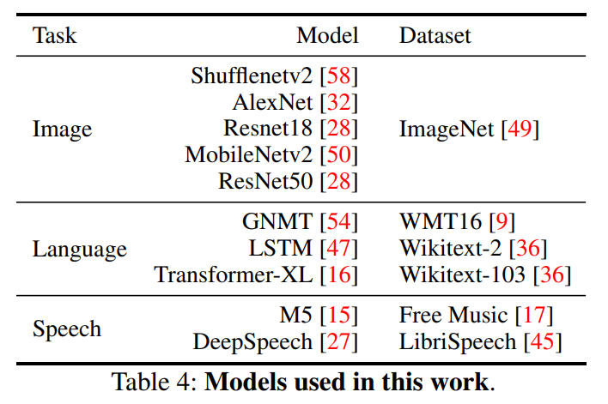
Evaluation
Experimental setup
Performed on 4 servers on a MS cluster
10 DNN models (CNNs, RNNs, LSTMs)
PyTorch 1.1.0
24 core CPU
500GB DRAM
V100 GPU X 8
Notes:
And evaluation.
So these are models used in this work. They used 10 DNN models and categorize by 3 task (image, language, and speech)
The physical setting is like this. On each server, it has 23 core CPU, 500GB DRAM, 8 v100, and ssd

Slide 25
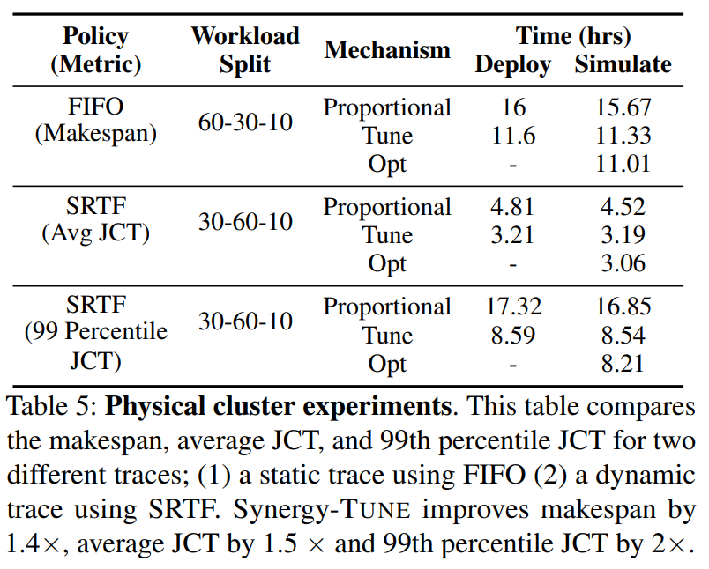
Evaluation
Physical cluster experiment
Synergy improves cluster objectives
(makespan, Avg JCT, 99p JCT)
Notes:
So this is physical cluster experiments of 3 scheduling policy. And as you can see in this table, on both deploy and simulation (by replaying the same trace), Synergy-tune reduces the makespan (time to complete all jobs submitted at the beginning of the trace) compared to GPU-proportional allocation.
And also, Synergy-tune are within 4 % of the optimal mechanism which is the upper bound.

Slide 26
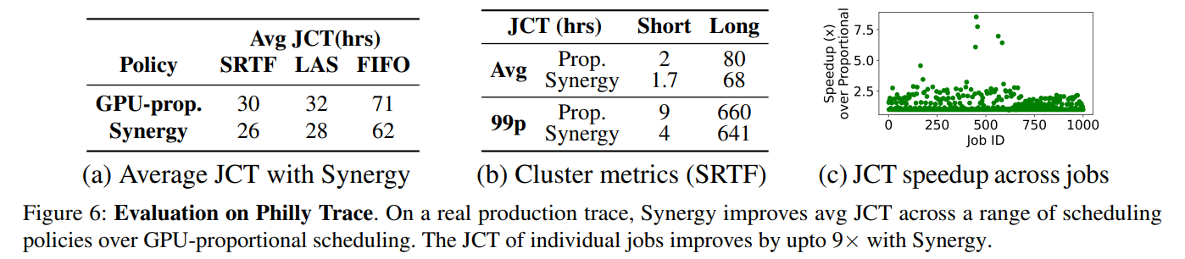
Evaluation
Simulation with production traces
Notes:
And this is the simulation results with Philly production trace. As you can see, Synergy improves average JCT over GPU-proportional scheduling across all policies. This is because Synergy can reallocate the underutilized resources from a job to a different, I mean resource-sensitive job. So the throughput can improve with the increased allocation.
And in the figure c, Synergy speeds up jobs by upto 9 ties using better resource allocations

Slide 27
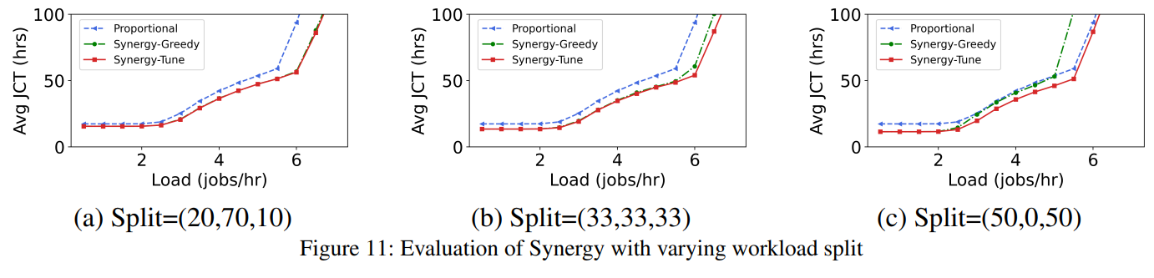
Evaluation
Impact of workload split (% of image, language, and speech models)
Notes:
And this is the evaluation of Synergy with varying workload split.
This 3 numbers represent the percentage of image, language, and speechmodels of the job. Workload split decides the percentage of resource sensitivie jobs in the workload.
In this figure 11, the x asis is the input load rate and y axis is average jct.
So… as the percentage of speech and image models increase in the trace, there may not be enough spare Cpu/memory resources because they are mostly CPU/memory hungry.
So for Synergy-tune, c is the worst case. But even in this case, synergy-tune performs as good as GPU-proportional allocation.
And Synergy supports higher load by efficiently utilizing resources to finish jobs faster than proportional.

Slide 28

Conclusion
DNN training jobs in the cluster have different CPU and memory sensitivity
Synergy profiles auxiliary resource requirement and performs workload-aware allocation
It gives unutilized resources from one job to another, improving job performance
https://github.com/msr-fiddle/synergy

Slide 29
Synergy: Looking Beyond GPUs for DNN Scheduling on Multi-Tenant Clusters
Jayashree Mohan, Amar Phanishayee, and Janardhan Kulkarni, MS Research; Vijay Chidambaram, The University of Texas and VMware Research
USENIX OSDI‘22
Thank You !
Presented by Yejin Han
yj0225@dankook.ac.kr

